Slide 1
Email Marketing:
Insights and Evolving Trends
By
Pramod C Pratap

Slide 2
Overview
Industry Outlook
  Insights & Facts
  Trends that are emerging
The Buzz in the Industry
  Burning Issues
    Spam, Deliverability
  Best Practices
Gearing up for Future
  Where Email Marketing is headed
  Services Vs Cost perspective
  Zustek: Going Forward

Slide 3
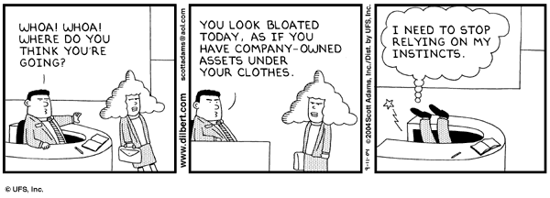
Industry Outlook
‘Facts & Figures’ ‘Industry Snapshot’
=Trends Emerging=

Slide 4
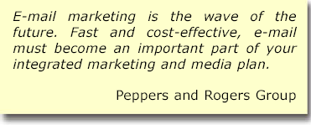
Email Marketing-Bare Facts
E-mail Marketing Spending Will Grow to $6.1 Billion in 2008 Budgets are huge 82 percent of marketers will embrace e-mail campaigns to market to existing customers, compared with 74 percent in 2003 Email Adoption is on the rise Though email marketing is < 1% of the total marketing budget, 76% of C Level Executives responded that they see significant increase in revenues through email Email is not just marketing;but sales/revenue driven E-mail marketing messages are sent at a cost of $5 to $7 per thousand while direct mailings cost $500 to $700 per thousand Email is most cost-effective | The average cost per message of opt-in e-mail is $.20, significantly cheaper than telemarketing ($1.00-$3.00 per message) or direct mail ($.75-$2.00 per message) Email is cheapest to reach audience medium Eighty percent of e-mail marketing message responses come back within 48 hours, as compared with the 6-8 week period for traditional direct marketing methods Email response time is faster Forty-five percent (119 million) of Americans now use e-mail;95 million e-mail users in Europe holding about 200 million e-mail accounts Email has the widest reach

Slide 5
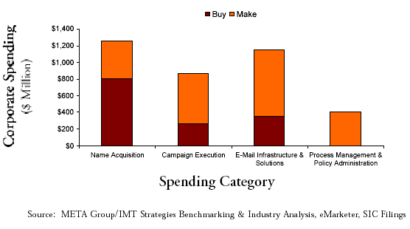
Current Industry Spends
This will come down significantly. House lists
give better response;
This will change
with offshoring
A lot of outsourcing will
be done here

Slide 6
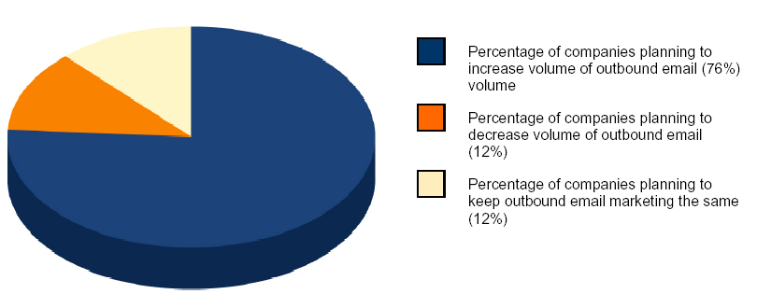
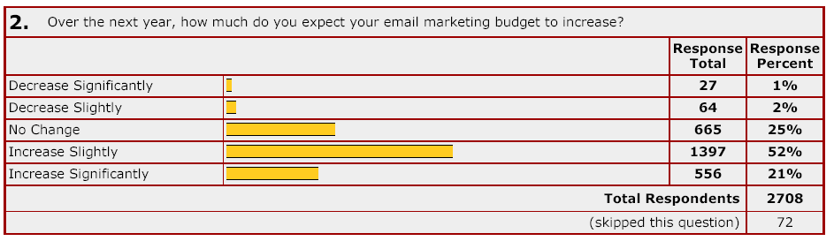
Email Industry Outlook
A study by Arial Software, there is a strong expectation
among companies
conducting email
marketing campaigns
More than 52% surveyed said that they will increase their marketing budgets significantly, according to survey by MarketingProfs
A significant number are also sensitive to readers’ needs and are more aware of negative effects like Spam

Slide 7
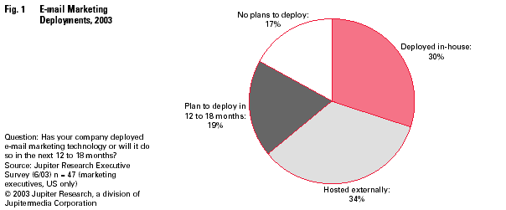
Email Deployments on the rise
Source: Jupiter Research
E-mail marketing deployments are now widespread
Lower costs are driving increases in E-mail Marketing deployments
Only half of them outsource technology to a hosted provider. So
plenty of market to garner
Lower costs are spurring greater adoption of more advanced
marketing tools; seeking more robust features

Slide 8
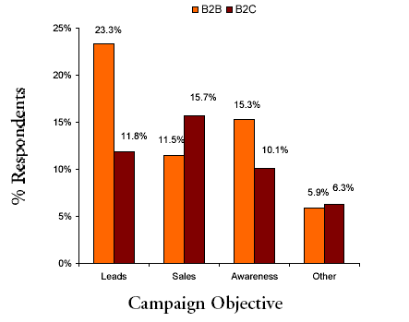
Create value for Emails
According to a META Group/IMT Strategies analysis, both B2C and B2B marketing organizations agree that email marketing meets a number of sales, marketing, service and communication objectives.
B2C companies look more to sales from email marketing than B2B who are more keen on leads
The challenge is to put the value of email on the income statement and balance sheet
Create business models that quantify the impact on revenues, costs, brands and customer relationships.

Slide 9
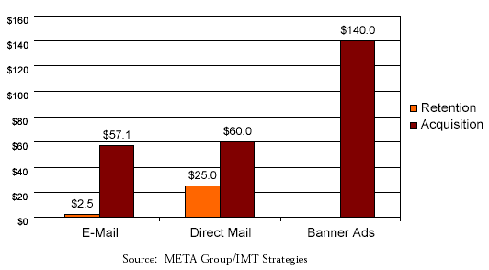
Email=Customer Retention
Email is ten times more effective than other direct marketing approaches;
What it takes $25 for direct mail, email does in $2.5
Email is particularly effective when used for customer retention, cross-selling
and upselling objectives
Concentrate on firms which focus on email programs on customer services and
retention goals
Find new ways to incorporate customer data to personalize and inform email
communications

Slide 10
Key Trends
Email marketing is clearly and markedly considered as cost-effective communication channels for companies
Companies are expected to increase their outbound email volumes in the next two years
Email marketing budgets of corporates too on the rise
Multi-part or dual-formatted messages are currently the most used format; the text format has lost its charm
Companies are increasingly getting sensitive to the needs of their recipients to differentiate their messages with Spam
Firms increasingly integrating email marketing with other media channels
Non-profit firms increasingly using email marketing compared to past

Slide 11
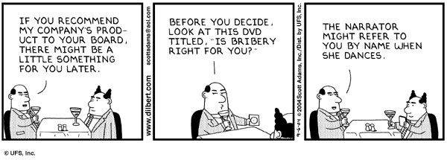
The Buzz in the Industry
‘Spam Scam’ ‘Deliverability’
=Best Practices=

Slide 12
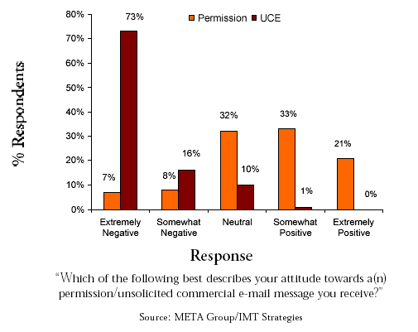
Spam=Scam
Without any doubt, Spam is the biggest hindrance to the growth of the industry. Marketers are more wary than before after the new CAN-SPAM Act
Sixty percent of companies indicate that erroneous Spam filters have had an adverse impact on their campaigns.
Outsourced e-mail marketing solutions are more adept at dealing with Spam filtering issues than in-house ones.

Slide 13
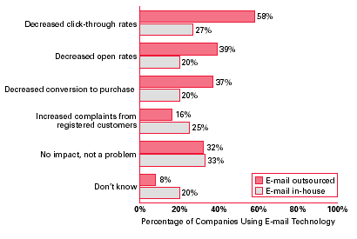
Spam’s Impact on Responses
Return Path reported recently
that 15 percent of emails do
not make it to in-boxes at the
top 10 e-mail account providers
While survey data suggests the
deliverability issue only resides
with those marketers using
outsourced solutions, Jupiter
Research believes those using
in-house solutions are affected
at the same rate.

Slide 14
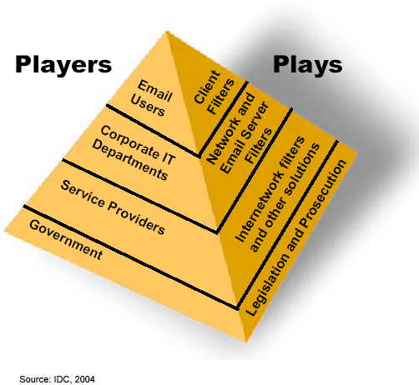
Who is doing what with regards to Spam?
Custom Software
Avoid Unwanted Emails;
Cautious about your
own email address
Network Firewalls
Big Joke -Their own emails get blocked!!
White/Black Listing & newer
Methods/technolgoies from the
Big 3 – MSN, Yahoo & AOL
CAN-Spam Act of 2003

Slide 15
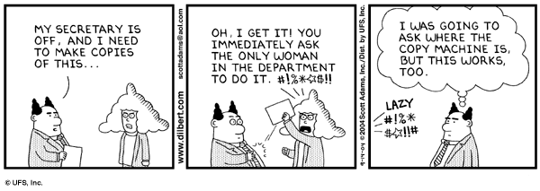
Solution? Follow some Best Practices
To make most of deliverability and less of Spam and more of responses= follow tried and tested ways
‘Best Practices’ you are most likely to know

Slide 16
‘Best Practices’ you are most likely to now
1. Avoid Spam Filters
  Less ‘Spamminess’ content
  Optimize wherever possible
2. Maximize Click-Thru Rates
  As simple as making clicks more visible
  Text WAS better; now studies show HTML
3. Personalize
  Call people with names
  Also do introduce yourself
4. Simple Unsubscribe
  Let it be known how simple it is
  And ensure you mean it
5. Sign-Up Confirmation
  Double Opt-In
  Welcome the new entrant

Slide 17
‘Best Practices’ you are most likely to now
6. Increase Response = Early part of week
  Tuesdays/Wednesdays best days
  But nothing tested nothing gained
7. Repeat Email Communication
  Use Auto Responders for instant confirmations
  Personalize emails later and communicate
8. Consistency is the key
  If newsletter, let people know when to expect
  Maintain look & feel;no one likes his newspaper change its format very frequently
9. On Time, Every Time
  Everywhere in life & email is no exception
10. Subject Line
  Its your first impression; read good and entice
  Be innovative; a lot of competing for attention

Slide 18
Gearing up for the future
Gearing up for Future
  Where Email Marketing Vendors are headed
  Services Vs Cost perspective
Zustek: Going Forward
  New Paradigm of Growth
    Internal
      Agency-Type of approach
      Project BECK
      Team RID
    External
      New Businesses
      Different tack to approach

Slide 19
Why Outsourcing to
Email Vendors will go Up?
Email as marketing medium will significantly improve
Businesses will want to differentiate themselves amid the clutter of consumers’ in-boxes
Marketers to look for creative, strategic and technical services
Desire to embrace industry best practices
Restricted resources internally; concentrate on the core
Coordinating email across multiple brands
Message delivery
On the downside:
  Difficulties in exchange of data, content
  Creative control
  Coordinating ongoing activities – as it becomes integral to marketing

Slide 20
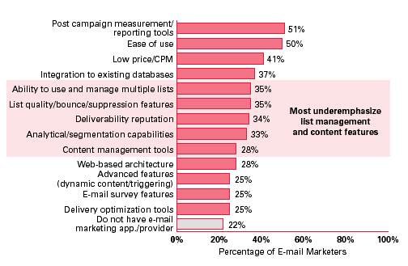
Survey of marketers on why they choose to outsource
Notice the top reasons
why marketers choose is
because of reporting
tools,ease of use and
even low costs.
This trend will change:
As campaigns become
more complicated and
evolve, the same criteria
will not be applicable
Analysis, deliverability,
creative services,
complex list/data
management are some
of the criteria that will
be hallmark of agency
selection

Slide 21
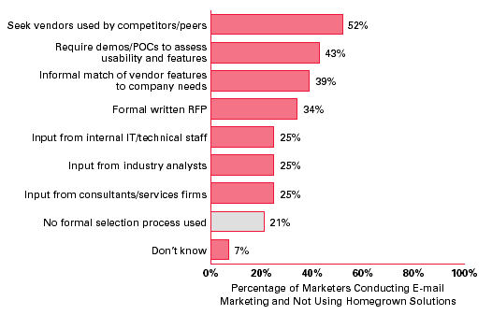
How marketers select their vendors?
You are what your competitors talk
The next best publicity is through demos and POCs to assess usability and features
(more in Project BECK)

Slide 22
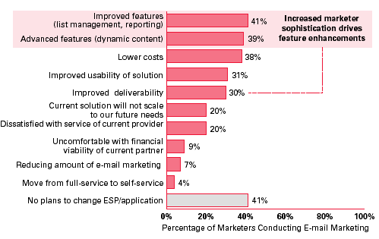
Why marketers switch their vendors?
Improved advanced
features that has made
them to switch the agencies

Slide 23
Why marketers switch their vendors?
Few marketers are loyal to vendors
Only less than half say they have no plans to change their vendor in the next year or so
Marketers will be compelled to move to solutions that offer advanced features
They will also be sensitive to:
  Importance of cost contradicts the value of deliverability
  Perceived value of usability diminishes over time; constantly innovate
  Service more important than financial viability
Marketers look short-term with vendors; with low switching barriers providing an easy exit

Slide 24
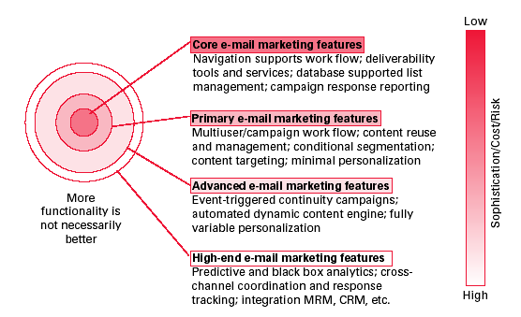
Vendor Offerings: From basic to high-end

Slide 25
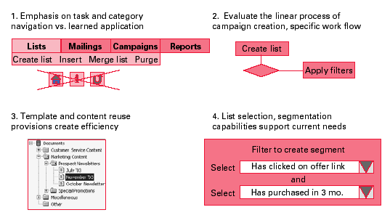
Scaling Up on application usability
Proprietary navigation tools for
new application features
Integrate intuitive provisions
Which improve work flow
Conditional filtering wizards that do not require database administrators to program segmentation queries
Store and manage content assets to speed campaign development

Slide 26
Zustek: Going Forward
New Paradigm of Growth
  Agency-approach
    Consultative/Analyst employee model
  Project BECK
    Branding, Events & Promotions(online), Communication and Kit (Media & Marketing)
    Online Initiatives – demo/ROI Calculator/Case Studies/White Papers/ Client Roster
  Team RID
    Research, Ideation & Development
    Comparative/Competitive Analysis
    Pre-Sales, Client Value Adds
    Industry Expertise - Knowledge Bank

Slide 27
Zustek in the vendor landscape
The Pluses
  Offshore presence; cost parameter; augurs well in the short-term to long-term
  Technology-centric as we have in-house R&D tech professionals
  Available pool of resources – cheap and scalable
  Envisage a integrated tool with LeadOp application
The Minuses
  Low on service quality
  Lack creative perspective
  Still settling down with operational road blocks
  No branching out into related domains – offline direct marketing

Slide 28
Agency Model Approach
3 C FS team members
  Creative
  Consultants
  Client Service
Research and Tech team are other two depts within FS but not on operations
All team members are consultants/analysts working for respective clients
  hierarchy works on associate consultant-consultant- senior consultant
  Senior Consultant leads to Analyst profile –lead analyst – senior analyst
  Each consultant builds expertise over a particular domain over a period of time
Technology is always a slave to man. eBizmailer is akin to MS-Outlook – a tool to communicate and increase efficiencies
Tech Issues should be solved as on SysSupport basis

Slide 29
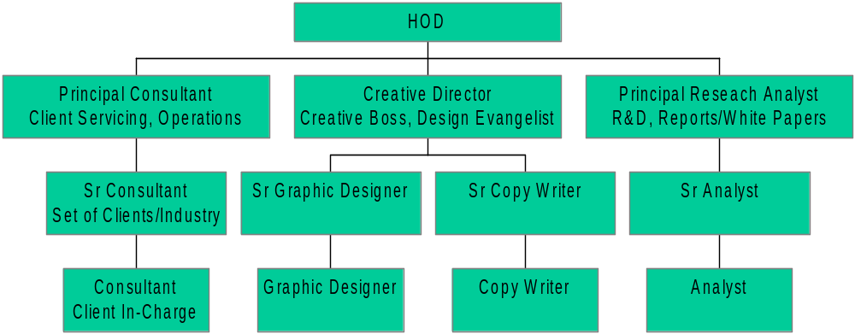
F S Team Structure

Slide 30
Project BECK
Branding
  Primarily online initiatives – newsletter
  Revamp web site, online flash demos, walk-through presentations, testimonials, resources section
Events & Promotions
  Online promotions
  Write articles, publish industry comments, do webinars
  Active participation in Industry Associations etc
Communications
  Online & Offline
  Internal & External, Employee & Client Communications
Kit
  Media Kit – Fact Sheet, Client Roster, Services
  Marketing Kit – Case Studies, White Papers, Best Practices, Solution Offerings

Slide 31
New Wing – Research, Ideation & Development (RID)
All marketing initiatives to be done by this new team
Reports, Analysis, white papers, case studies under the purview of Research & Ideation
Comparative and Competitive Benchmarking – to come up with quarterly vision documents
To be on all major client calls – new and big projects, non-operational calls, helping clients with new value adds
New models/processes/reporting templates/technology/legal issues need to be constantly updating and disseminate the information across the organization
All pre-sales research on industry

Slide 32
THANK YOU

